Slide 1
The Kingdom view of the Reformation
Him or It?

Slide 2
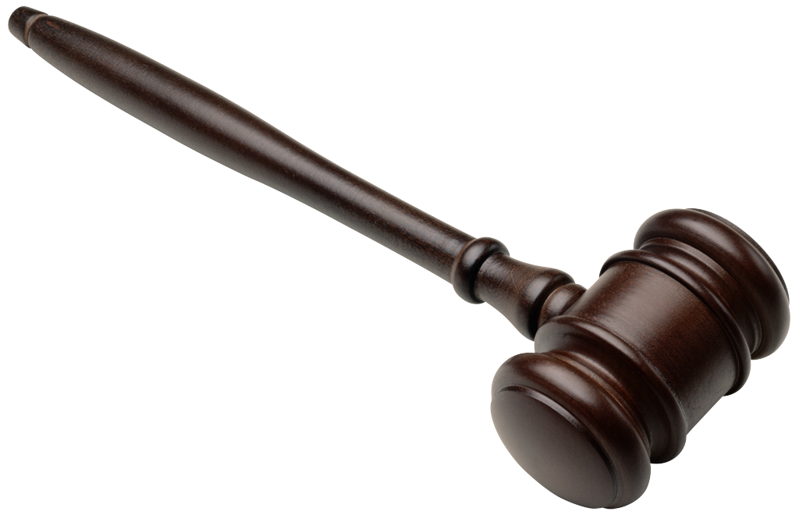


Slide 3
Killer in Heaven??
Writing a year before the murders, George Sodini wrote in his journal about his involvement in church. Speaking about the pastor of the church he attended for 13 years he said, “this guy teaches (and convinced me) you can commit mass murder then still go to heaven.”
A year later.. (The capital letters are all from Sodini’s own words):
“Maybe soon, I will see God and Jesus. At least that is what I was told. Eternal life does NOT depend on works. If it did, we will all be in hell. Christ paid for EVERY sin, so how can I or you be judged BY GOD for a sin when the penalty was ALREADY paid. People judge but that does not matter. I was reading the Bible and The Integrity of God beginning yesterday, because soon I will see them.”

Slide 4
“At least that is what I was told”
Who told George Sodini that a person could kill someone and not “lose their salvation”?
Who told George Sodini that faith existed only in mental beliefs?
Who told George Sodini that his actions did not matter to God?
Who told George Sodini that “grace” was some kind of blanket forgiveness policy?
Who came up with this strange doctrine?

Slide 5
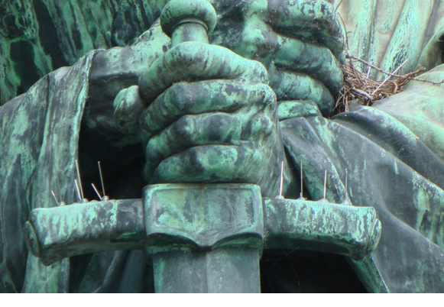
The Reformation

Slide 6
Life in Switzerland
Households existed within a community structure, either rural or urban. Communities were organized by the secular and ecclesiastical lords. Rural lords established conditions of labor and land usage. The village church was both a spiritual and social center, a focal point for holidays and celebrations. Communities expressed their social solidarity by ceremonial activities in which all members of the village participated. In rural villages, priests led residents in annual perambulations of the lands. In towns, ceremonial processions were more formal and reflected the greater social stratification of urban life. Weddings were significant ceremonies for the entire community. Marriages bound families—and often wealth—together. They marked the admission of a new household to the community. Weddings were public affairs. Other festivals were associated with the passage of stages of the agricultural cycle. Festivals released community members from labor and presented opportunities to resolve community squabbles. Festivals also offered the chance for the social hierarchy of the community to be placed on public display.

Slide 7
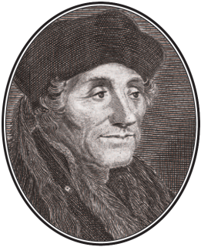
Erasmus
In the 1515 edition he wrote a long discourse on why war is sweet only to those who have not tried it (to the inexperienced).
In 1516 Erasmus published his new translation of the New Testament in Greek.
Promoting the use of the Bible in the vernacular, in stressing that “Christianity is essentially a life of discipleship of Christ,”

Slide 8
Frogs and Locusts
“The Anabaptists have flooded the Low Countries just as the frogs and locusts flooded Egypt, a mad generation, doomed to die. They slipped in under the appearance of piety, but their end will be public robbery. And what is like a miracle, although they teach absurdities, not to say impossibilities, and although they spread unlovely things, the populace is attracted as if by a fateful mood or rather the impulse of an evil spirit in this sect.”

Slide 9
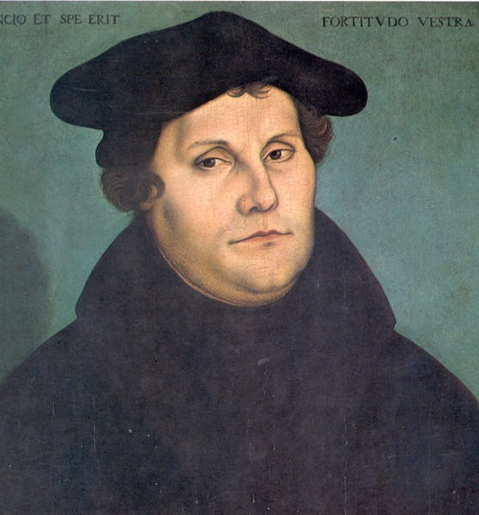
Martin Luther
Born November 10, 1483
In 1511 Luther was sent to to Wittenberg.
Pouring himself now into his students instead of himself, he began to study the original languages, Greek, Hebrew. In these studies it hit him as a Revolution. You must simply receive. “I felt myself to be “born again,” and entering into the gaits of heaven.

Slide 10
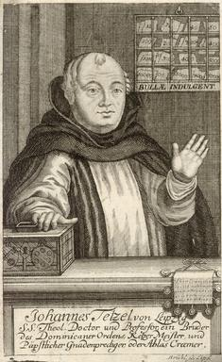
October 31, 1517
“As soon as a coin in the coffer rings --the soul from purgatory springs.”
As Tetzel came in people left Luther’s preaching and he didn’t like that. So on October 31 1517 he grabbed some paper and a quill and wrote down on some paper 95 reasons against this practice and nailed them on door of the Castle Church door.
1521 Diet of Worms.

Slide 11
State Church part II
Eventually excommunicated.
Luther turned to the printing press. In a crafty political move he wrote a booklet- not to the theologians- but to the kings and princes of Germany. The name of his tracts was:
“To the Christian Nobility of the German Nation.”

Slide 12
“Here I stand”
“"Unless I am convicted by Scripture and plain reason -- I do not accept the authority of popes and councils, for they have contradicted each other -- my conscience is captive to the word of God. I cannot and I will not recant anything, for to go against conscience is neither right nor safe. God help me. Amen." At the end of his long defense “Here I stand I can do no other. God help me, Amen.”

Slide 13
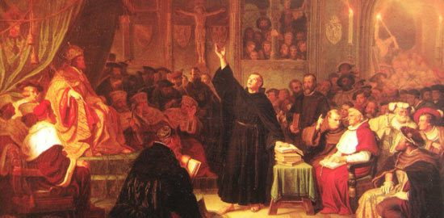
Here I stand

Slide 14
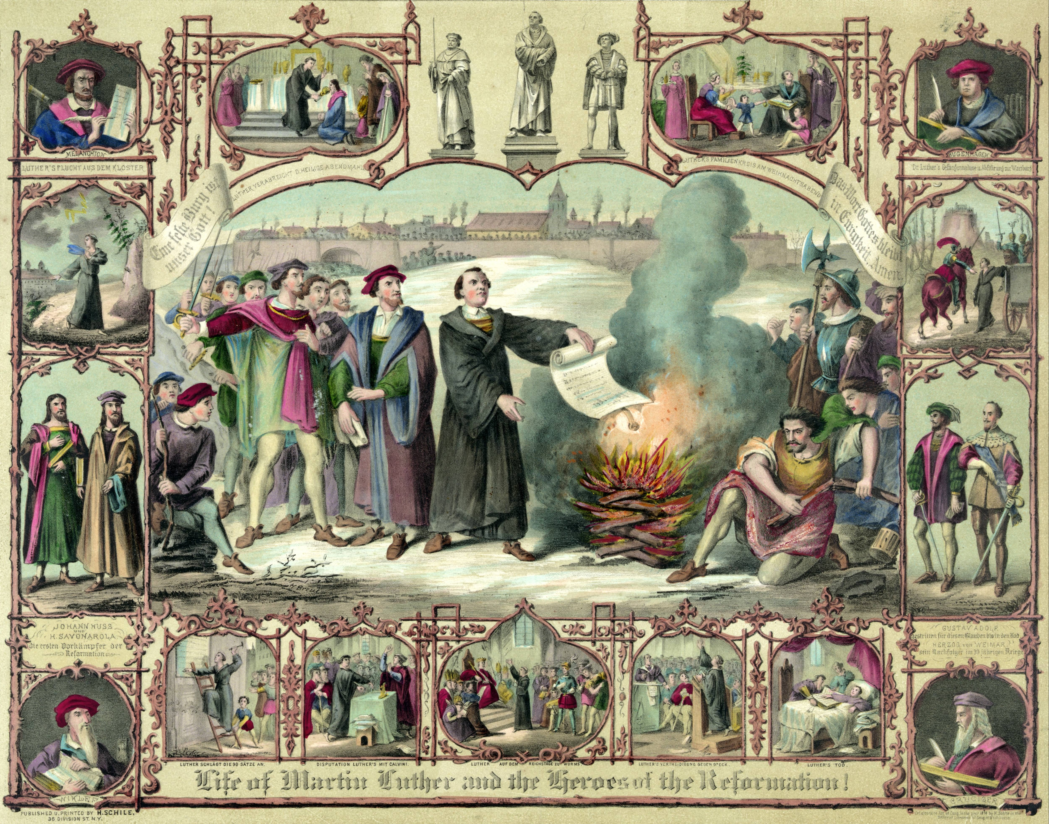

Slide 15
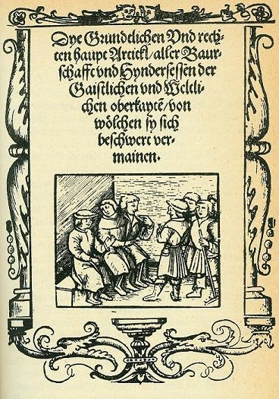
The Peasant Revolt
1524–1526

Slide 16
Protestant Crusaders
The rulers have a good conscience and a just cause. Therefore, they can say to God with all assurance of heart, “These peasants have deserved death many times over. Therefore, I will punish and smite as long as my heart beats.”
Thus it may be that one who is killed fighting on the ruler’s side may be a true martyr in the eyes of God. Strange times, these, when a prince can win heaven with bloodshed, better than other men with prayer! Therefore, dear lords, stab, smite, slay, whomever you can. If you die in doing it, well for you! A more blessed death can never be yours.

Slide 17
Luther on the Anabaptists
The Anabaptists set up a ministry and congre­gation of their own, which is also contrary to the command of God. From all this it be­comes clear that the secular au­thorities are bound . . . to inflict corporal punish­ment on the offenders. . . . Also when it is a case of only upholding some spiritual tenet, such as infant baptism, original sin, and unnecessary separation, then . . . we conclude that . . . the stubborn sectarians must be put to death.

Slide 18
Against the Jews
First, set fire to their synagogues or schools and bury and cover with dirt whatever will not burn, so that no man will ever again see a stone or cinder of them. This is to be done in honor of our Lord and of Christendom, so that God might see that we are Christians.
Second, I advise that their houses also be razed and destroyed. This will bring home to them the fact that they are not masters in our country, as they boast. Third, I advise that all their prayer books and Talmudic writings be taken from them. Fourth, I ad­vise that their rab­bis be forbidden to teach on pain of loss of life and limb.

Slide 19
Enslave them?
Fifth, I advise that safe-conduct on the high­ways be abolished completely for the Jews. For they have no business in the countryside, since they are not lords, officials, tradesmen, or the like. Let them stay at home. For you must not and cannot protect them unless you wish to be­come participants in their abom­inations in the sight of God.
Sixth, I advise that charging interest be prohi­bited to them, and that all cash and treas­ure of silver and gold be taken from them and put aside for safe­keeping. Through usury, they have stolen and robbed from us all they possess.
Seventh, I recommend putting a flail, an ax, a hoe, a spade, a distaff, or a spindle into the hands of young, strong Jews and Jewesses and letting them earn their bread in the sweat of their brow. For it is not fitting that they should let us accursed Gentiles toil in the sweat of our faces while they, the holy people, idle away their time behind the stove, feasting and passing gas, and on top of all, boasting blasphemously of their lordship over the Christians by means of our sweat. No, we should toss out these lazy rogues by the seat of their pants.
Finally, let us emulate the common sense of other nations such as France, Spain, and Bohemia and eject them forever from the country.

Slide 20


Slide 21
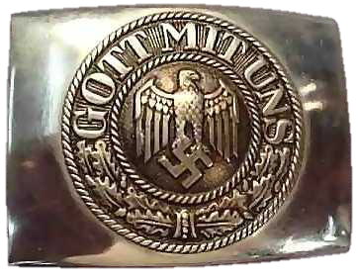
Nazi revival

Slide 22
Sin boldly!
If you are a preacher of mercy, do not preach an imaginary but the true mercy. If the mercy is true, you must therefore bear the true, not an imaginary sin. God does not save those who are only imaginary sinners. Be a sinner, and let your sins be strong, but let your trust in Christ be stronger, and rejoice in Christ who is the victor over sin, death, and the world. We will commit sins while we are here, for this life is not a place where justice resides. We, however, says Peter (2. Peter 3:13) are looking forward to a new heaven and a new earth where justice will reign. It suffices that through God's glory we have recognized the Lamb who takes away the sin of the world. No sin can separate us from Him, even if we were to kill or commit adultery thousands of times each day. Do you think such an exalted Lamb paid merely a small price with a meager sacrifice for our sins? Pray hard for you are quite a sinner.” (A Letter From Luther to Melanchthon, Letter 99, 1 August 1521).

Slide 23
Ulrich Zwingli
1498 entered seminary
1515 slaughter of 6000 Swiss mercenaries
Met Erasmus in 1514. Pacifism, love
1516 Greek NT…nothing can stop me from learning Greek.
Jan 1, 1519 1st sermon in Zurich
1519 almost died from Plague.
1521….start a bible college.
Conrad Grebel joined him radical discussions about infant baptism, pacifism and radical views of economics.
1522… public debate against lent practices.

Slide 24
Conrad Grebel
Tension at home…. Concerning his mother:
“She’s ungodly toward me, and to my wife she’s downright rabid. I actually fear for her salvation unless she puts on Christ and becomes a new creature born again by the divine Spirit. And now the time is drawing close when most people eat the body of Christ unworthily, if they haven’t forgiven the trespasses of others in a brotherly spirit.” O Christ, send Vadian or something like him to teach her from your truth to give up such ungodliness, and to teach me patience.”

Slide 25
Trouble begins
October of 1523, the city council will determine how the mass is to be celebrated.
Conrad starts networking… and writing. People like Tomas Muntzer.

Slide 26
Complicated Interpretation
Exhorting his friend Vadian about compromise and materialism, Conrad wrote: “Achieving financial advantage brings us, at best, a temporary happiness in this world, and it can often disguise the naked force which supports it. It is impossible to reconcile the love of money with God’s truth. I believe the Word of God without a complicated interpretation, and out of this belief I speak. May God give you the mercy to submit to His Word without reservation, and obey it. Otherwise, things probably don’t stand as well with us as we might hope. The way is narrow.”

Slide 27
Follow Him
The letter ends, “The teaching of the Lord has been given for the purpose of being put into practice.”

Slide 28
Infant Baptism
January 5, 1525 Baby Rachel was born. January 17, 1525 debate started. Followed by a decree.
New comer came in described as “ the one in the blue coat.” He was “wild in manner.”
Mandate on 18 and 21.
January 21, 1525 baptism.

Slide 29
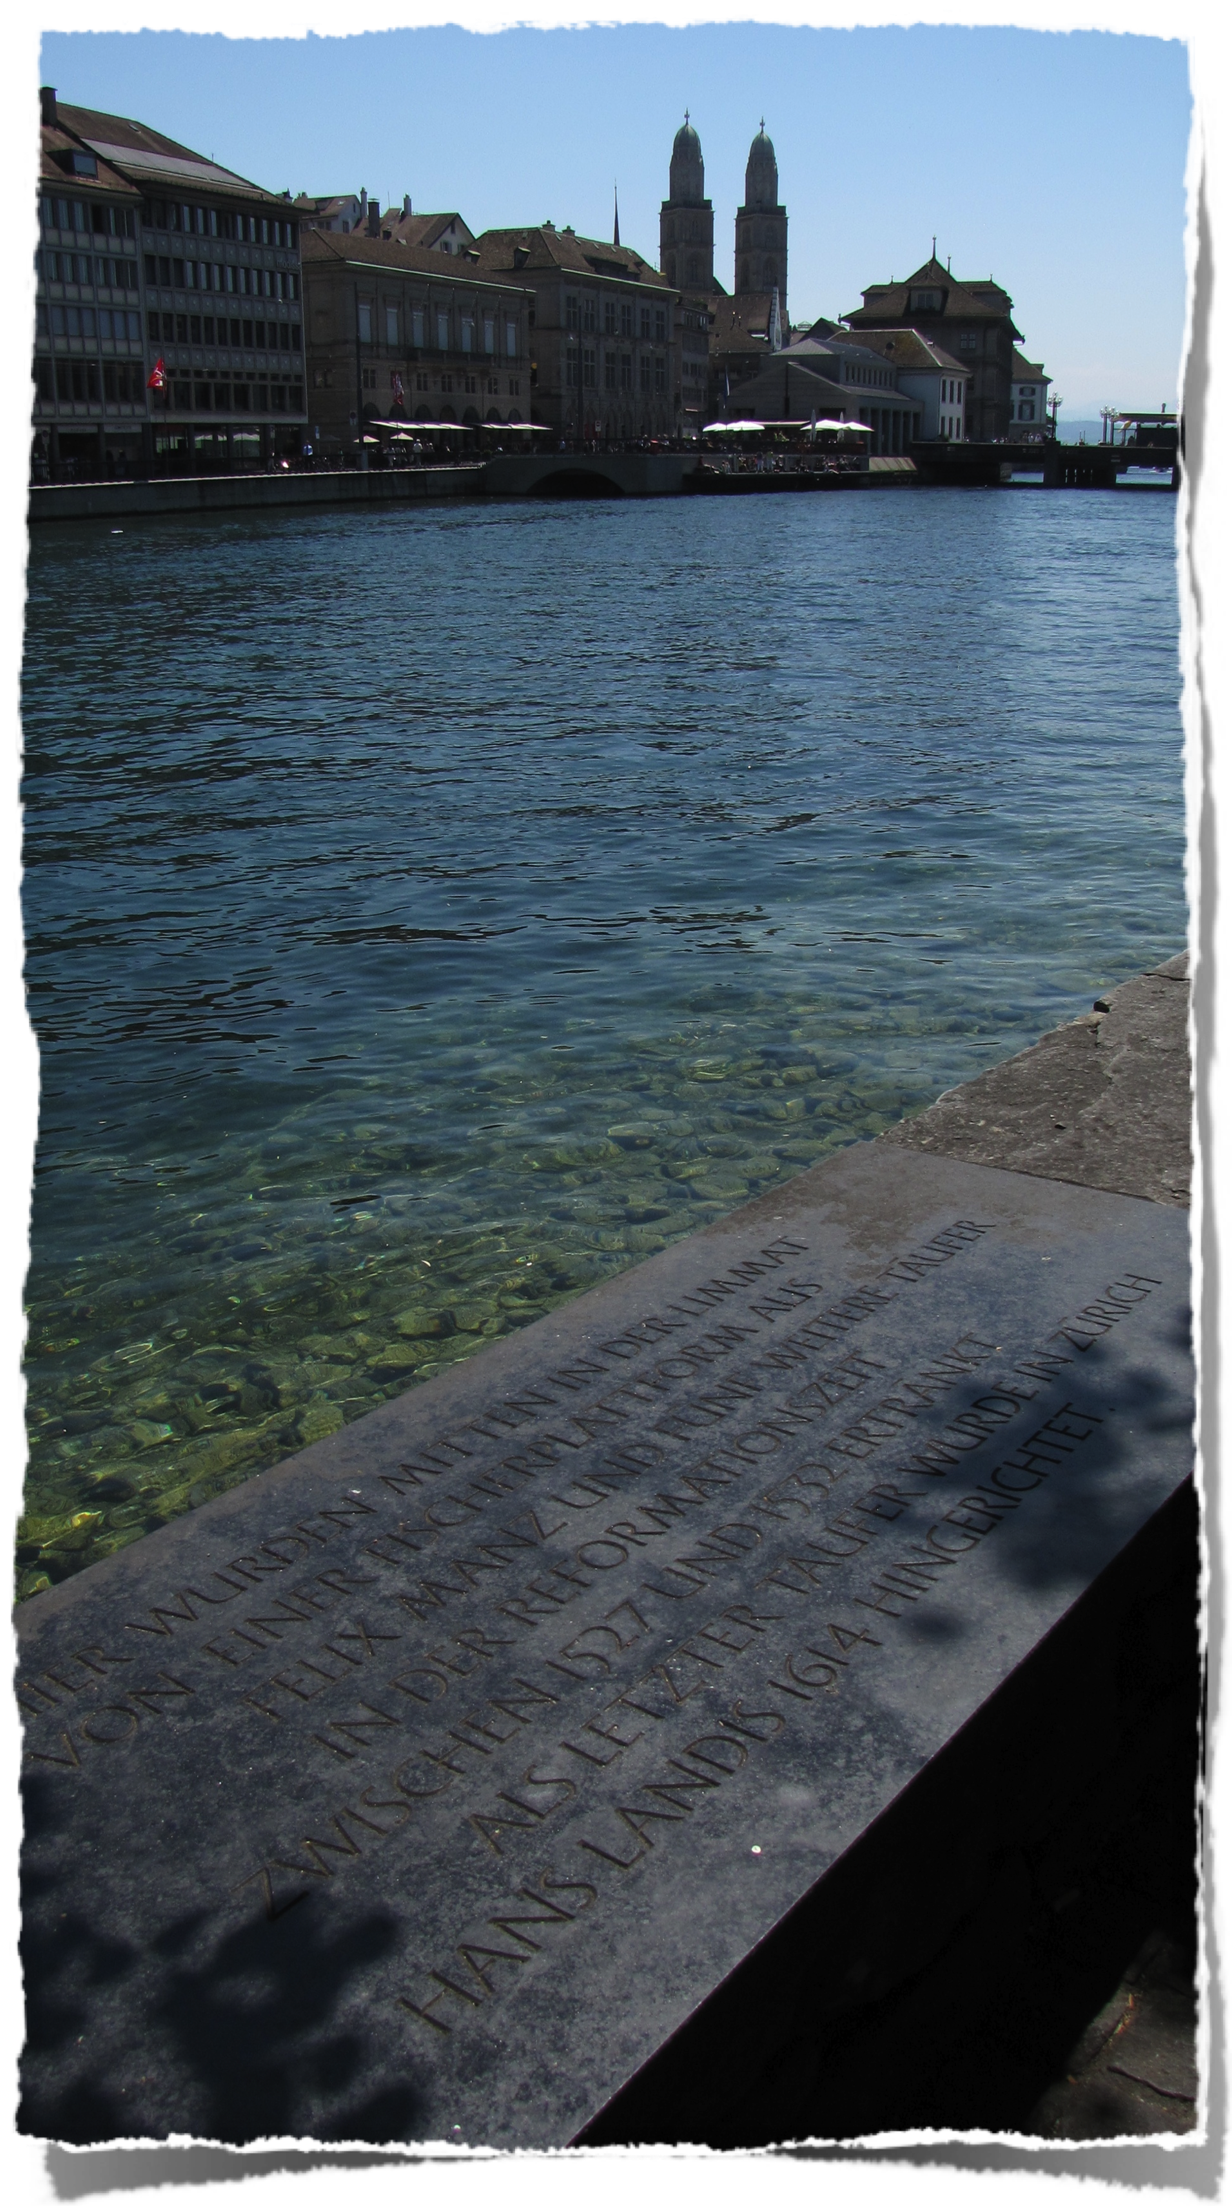
Martyrdom
On January 5, 1527 Felix Manz was sentenced to death!
“Because contrary to Christian order and custom he had become involved in Anabaptism, had accepted it, taught others, and become a leader and beginner of these things, because he confessed having said that he wanted to gather those who wanted to accept Christ and follow Him, and unite himself with them through baptism, and let the rest live according to their faith, so that he and his followers separated themselves from the Christian Church and were about to raise up and prepare a sect of their own under the guise of a Christian meeting and church; because he had condemned capital punishment.

Slide 30
Felix Manz
, ... since such doctrine is harmful to the unified usage of all Christendom, and leads to offense, insurrection, and sedition against the government, to the shattering of the common peace, brotherly love, and civil cooperation and to all evil, Manz shall be delivered to the executioner, who shall tie his hands, put him into a boat, take him to the lower hut, there strip his bound hands down over his knees, place a stick between his knees and arms, and thus push him into the water and let him perish in the water; thereby he shall have atoned to the law and justice. . . . His property shall also be confiscated by my lords.”

Slide 31
The Congregational Order
Since the almighty eternal and merciful God has made His wonderful light break forth in this world and [in this] most dangerous time, we recognize the mystery of the divine will, that the Word is preached to us according to the proper ordering of the Lord, whereby we have been called into His fellowship. Therefore, according to the command of the Lord and the teachings of His apostles, in Christian order, we should observe the new commandment, in love one toward another, so that love and unity may be maintained, which all brothers and sisters of the entire congregation should agree to hold to as follows:
The brothers and sisters should meet at least three or four times a week, to exercise themselves, in the teaching of Christ and His apostles and heartily to exhort one another to remain faithful to the Lord as they have pledged.
When the brothers and sisters are together, they shall take up something to read together. The one to whom God has given the best understanding shall explain it, the others should be still and listen, so that there are not two or three carrying on a private conversation, bothering the others. The Psalter shall be read daily at home.
Let none be frivolous in the church of God, neither in words nor in actions. Good conduct shall be maintained by them all also before the heathen.

Slide 32
Discipline and love
When a brother sees his brother erring, he shall warn him according to the command of Christ and shall admonish him in a Christian and brotherly way, as everyone is bound and obliged to do out of love.
Of all the brothers and sisters of this congregation none shall have anything of his own, but rather, as the Christians in the time of the apostles held all in common, and especially stored up a common fund, from which aid can be given to the poor, according as each will have need, and as in the apostles time permit no brother to be in need.
All gluttony shall be avoided among the brothers who are gathered in the congregation; serve a soup or a minimum of vegetable and meat, for eating and drinking are not the kingdom of heaven.
The Lord's supper shall be held, as often as the brothers are together, thereby proclaiming the death of the Lord, and thereby warning each one to commemorate, how Christ gave His life for us, and shed His blood for us, that we might also be willing to give our body and life for Christ's sake, which means for the sake of all the brothers.

Slide 33
Early Anabaptist letter
“While yet in the national church, we obtained much instruction from the writings of Luther, Zwingli, and others, concerning the mass and other papal ceremonies, that they are vain. Yet we recognized a great lack as regards repentance, conversion, and the true Christian life. Upon these things my mind was bent. I waited and hoped for a year or two, since the minister had much to say of amendment of life, of giving to the poor, loving one another, and abstaining from evil. But I could not close my eyes to the fact that the doctrine which was preached and which was based on the Word of God, was not carried out. No beginning was made toward true Christian living, and there was no unison in the teaching concerning the things that were necessary.”

Slide 34
Repentance evidenced by fruits
“And although the mass and the images were finally abolished, true repentance and Christian love were not in evidence. Changes were made only as concerned external things. This gave me occasion to inquire further into these matters. Then God sent His messengers, Conrad Grebel and others, with whom I conferred about the fundamental teachings of the apostles and the Christian life and practice. I found them men who had surrendered themselves to the doctrine of Christ by “Bussfertigkeit” [repentance evidenced by fruits]. With their assistance we established a congregation in which repentance was in evidence by newness of life in Christ.”

Slide 35
Schleitheim confession
IV. We are agreed (as follows) on separation: A separation shall be made from the evil and from the wickedness which the devil planted in the world; in this manner, simply that we shall not have fellowship with them (the wicked) and not run with them in the multitude of their abominations.
This is the way it is:
Since all who do not walk in the obedience of faith, and have not united themselves with God so that they wish to do His will, are a great abomination before God, it is not possible for anything to grow or issue from them except abominable things. For truly all creatures are in but two classes, good and bad, believing and unbelieving, darkness and light, the world and those who (have come) out of the world, God's temple and idols, Christ and Belial; and none can have part with the other.

Slide 36
“His sons and daughters”
To us then the command of the Lord is clear when He calls upon us to be separate from the evil and thus He will be our God and we shall be His sons and daughters.
He further admonishes us to withdraw from Babylon and earthly Egypt that we may not be partakers of the pain and suffering which the Lord will bring upon them.
From this we should learn that everything which is not united with our God and Christ cannot be other than an abomination which we should shun and flee from.

Slide 37
“Once Delivered”
Jud 1:3 Beloved, when I gave all diligence to write unto you of the common salvation, it was needful for me to write unto you, and exhort you that ye should earnestly contend for the faith which was once delivered unto the saints.

Slide 38
Righteousness of God
2Co 5:20 Now then we are ambassadors for Christ, as though God did beseech you by us: we pray you in Christ's stead, be ye reconciled to God. For he hath made him to be sin for us, who knew no sin; that we might be made the righteousness of God in him.

